Slide 1


Noida Institute of Engineering and Technology, Greater Noida
Planning & Learning
Unit: 05
B Tech 3rd Sem)
Alka Singh
CSE - AIML

Slide 2
Probabilistic Methods
The probabilistic method is a nonconstructive method, primarily used in combinatorics and pioneered by Paul Erdős, for proving the existence of a prescribed kind of mathematical object.
The idea of the method is that in order to prove the existence of an object one designs a non-deterministic algorithm that may or may not produce the desired object
So, a probabilistic method or model is based on the theory of probability or the fact that randomness plays a role in predicting future events.

Slide 3
Terms used in Probability
Probabilistic approach provides insights into the reliability of the plant systems, interactions and weaknesses in the design, the application of defence in depth, and risks that it may not be possible to derive from a deterministic analysis.
Probabilistic data is information that is based on relational patterns and the likelihood of a certain outcome. For example: probabilistic data is used in weather forecasting, where a value is based off of past conditions and probability.

Slide 4
Challenges to implement Prob. methods
Data matching: if a probabilistic model has too many parameters, then it is difficult to learn it efficiently, and we would also need a large number of training data to learn it accurately.

Slide 5
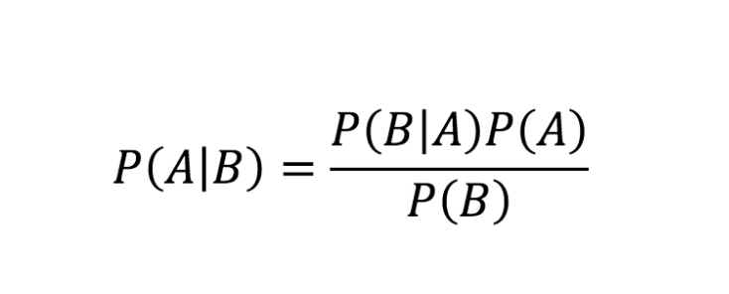
Bayesian Theory
Bayesian Theory is a mathematical formula for determining conditional probability. Conditional probability is the likelihood of an outcome occurring, based on a previous outcome occurring.
where,
A, B are events;
P(A|B) = Probability of A given B is true;
P(B|A) = Probability of A given B is true;
P(A), P(B) are independent probabilities;

Slide 6
Dempster-Shafer Theory
Dempster-Shafer Theory is a general framework for reasoning with uncertainty, with understood connections to other frameworks such as probability, possibility and imprecise probability theories. It is known as ‘The theory of belief functions’, also referred to as evidence theory.
It is given by Arthure P.Dempster in 1967 and his student Glenn Shafer in 1976.

Slide 7
Features of Dempster-shafer Theory
Unlike Bayesian theory, DST is an evidence theory, it combines all possible outcomes of the problem. Hence it is used to solve problems where there may be a chance that a different evidence will lead to some different result. The uncertainty in this model is given by:-
Consider all possible outcomes.
Belief will lead to believe in some possibility by bringing out some evidence.
Plausibility will make evidence compatibility with possible outcomes.

Slide 8
Characteristics of DST
It will ignorance part such that probability of all events aggregate to 1.
Ignorance is reduced in this theory by adding more and more evidences.
Combination rule is used to combine various types of possiblities.

Slide 9
Advantages & Disadvantages of DST
Advantages:
As we add more information, uncertainty interval reduces.
DST has much lower level of ignorance.
Diagnose Hierarchies can be represented using this.
Person dealing with such problems is free to think about evidences.
Disadvantages: In this computation effort is high, as we have to deal with 2n of sets.

Slide 10
Bayesian network
Bayesian network is a probabilistic graphical model which represents a set of variables and their conditional dependencies using a directed acyclic graph.
Bayesian networks are probabilistic, because these networks are built from a probability distribution, and also use probability theory for prediction and anomaly detection.

Slide 11


